Slide 1

CSC 203 / CPE 203
Week 3
Project-Based Object-Oriented
Programming and Design
(using Java)
Bill Foote
wffoote@calpoly.edu
(http://jovial.com)
Notes:
M: 1-14
T:; 1-22
W: To, or through python vars
R: UP to javadocs @ end
F: through 49

Slide 2
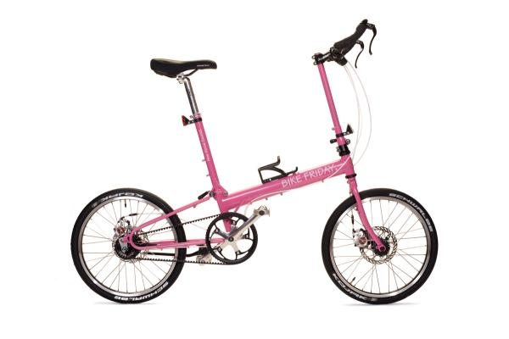
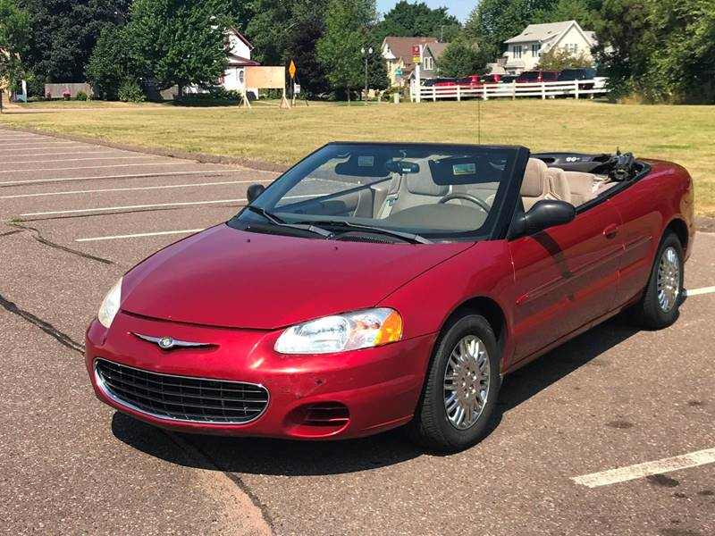
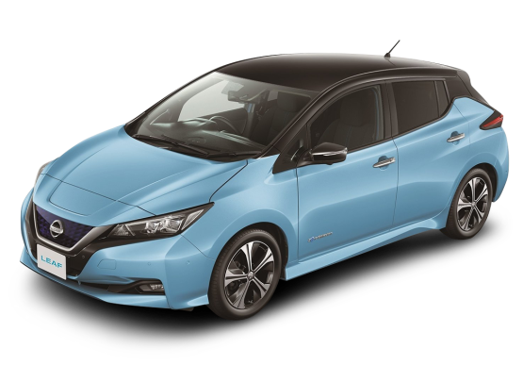
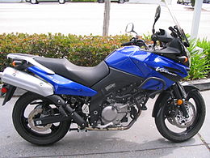
Interfaces and Polymorphism
Sebring s = new Sebring();
s.move();
Bicycle b = new Bicycle();
b.move();
+move()
+move()
+move()
+move()
+move()

Slide 3
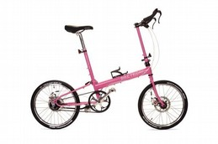
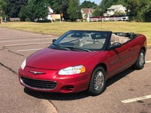
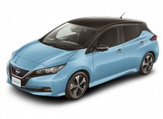
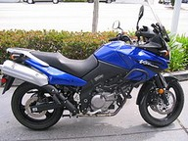
<<interface>>
Vehicle
+move()
+move()
+move()
+move()
+move()
+move()
+move()

Slide 4
List list
= new ArrayList<Vehicle>();
list.add(new Sebring());
list.add(new Bicycle());
for (Vehicle v : list) {
v.move();
}
<<interface>>
Vehicle
TYPE:
v is of Type “Vehicle”
Sebring, Car, etc. are Subtypes
+move()
+move()
+move()
+move()
+move()
+move()
+move()

Slide 5
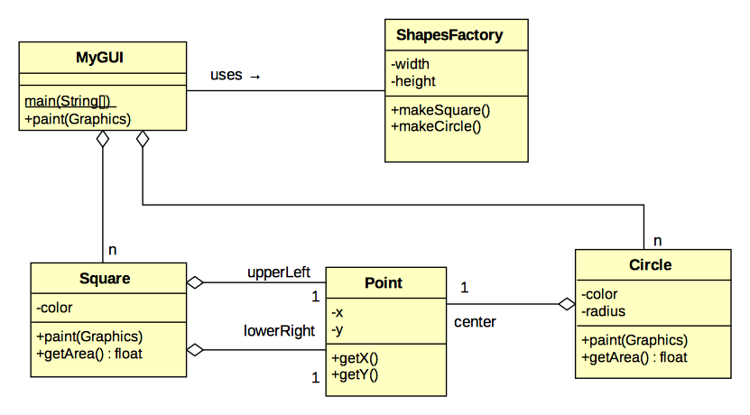
Before…
But we don’t really care about point...

Slide 6
Before...

Slide 7
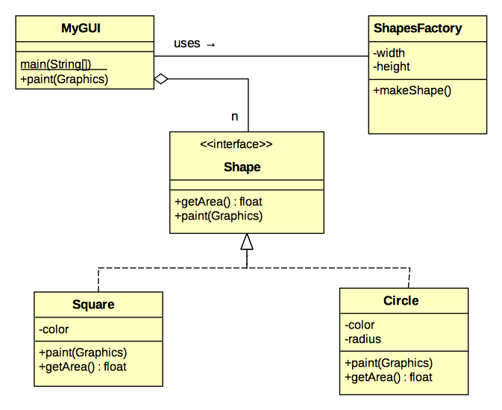

Slide 8
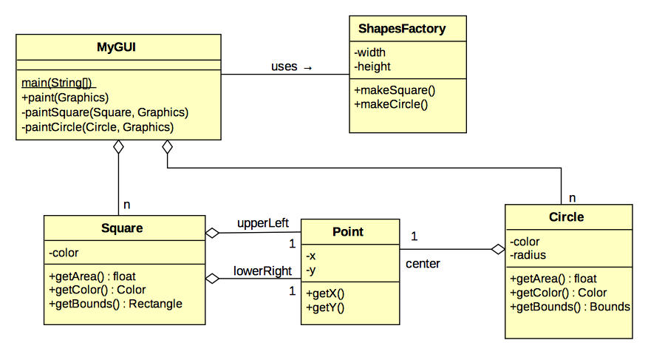
But what do we do with the “Single Responsibility” version?

Slide 9
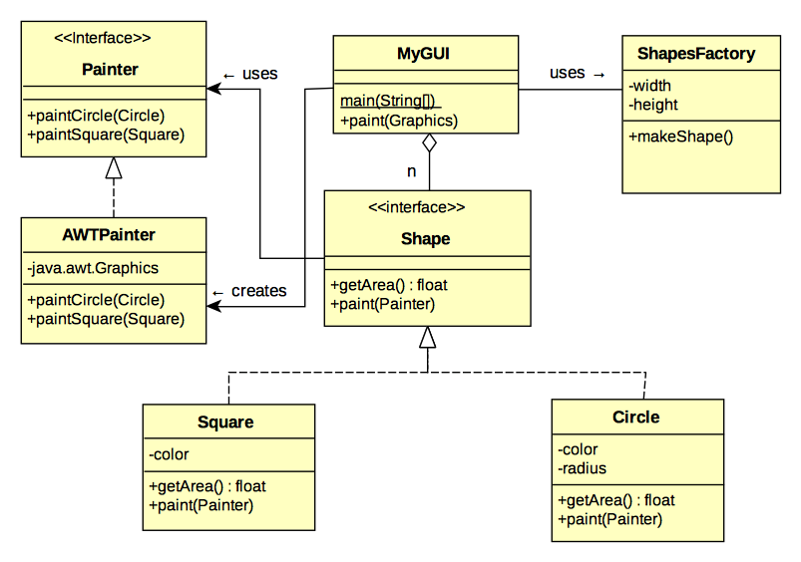

Slide 10

https://polylearn.calpoly.edu/AY_2017-2018/pluginfile.php/666124/block_html/content/Gamma_Design%20Patterns%20inside%20cover.pdf
https://polylearn.calpoly.edu/AY_2017-2018/pluginfile.php/666124/block_html/content/Gamma_Design%20Patterns.pdf

Slide 11
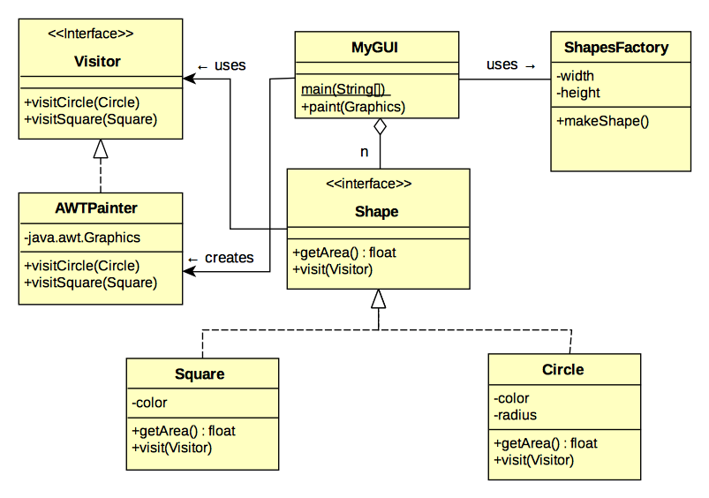
Visitor
Pattern

Slide 12
Code
(Code in 2_single_resp_code)

Slide 13
Ponder this:
What happens to the Visitor design version when we want to add triangles?

Slide 14
Another Kind of Polymorphism
“Implementation Inheritance”
  Usually just “Inheritance”

Slide 15
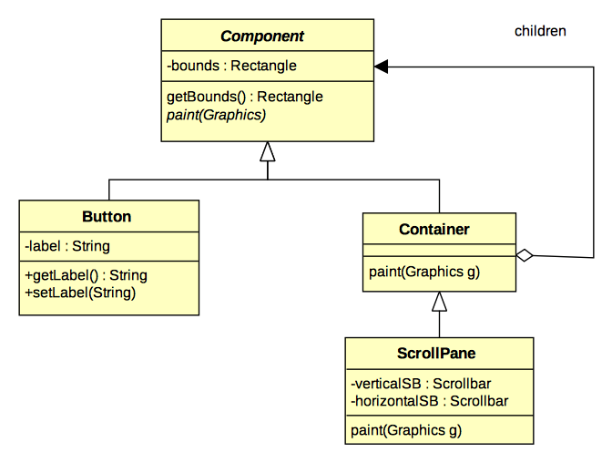

Slide 16
https://docs.oracle.com/javase/8/docs/api/index.html?java/awt/Component.html
week_03/impl_inheritance.txt

Slide 17
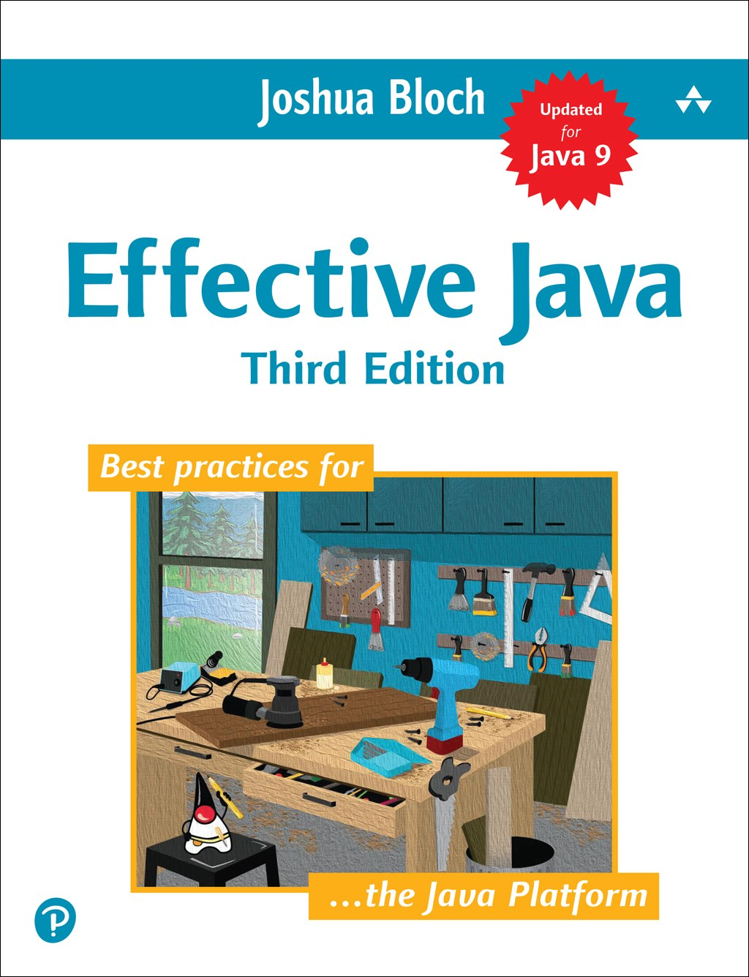
Interfaces vs. Superclasses
When you have a choice, prefer interfaces
  To much subclassing leads to fragile code
A class can only have one superclass, but it can implement multiple interfaces

Slide 18
DRC needs a Note Taker
[Please] “make an announcement, or re-announce, the need for a note taker to class participants: you can refer them to our office, bldg 124/119 to sign up, get instructions and enter a drawing for a $25 gift card”
You can take pictures of your notes with a smartphone.
“ask a class participant to be a note taker: if they agree, refer them to our office and contact [jcbarker@calpoly.edu] with their contact information”

Slide 19
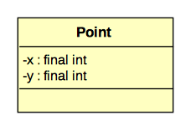

Slide 20
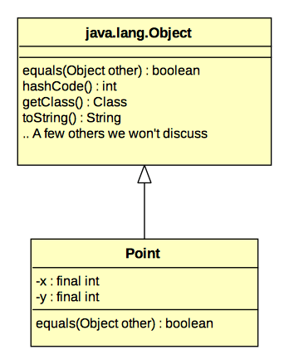

Slide 21
Are all objects created .equals()?
See 4_equals/1/Main.java for the answer!

Slide 22
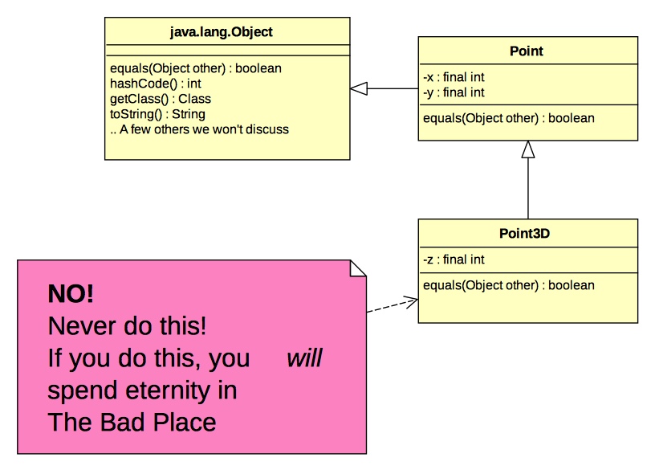


Slide 23
Recommended Approach
You don’t always have to implement equals()!
equals() is often useful for “data holder” classes, especially ones used as keys in maps
Data holder classes should usually be final, so that they can’t be subclassed
So, finally...

Slide 24
So much yes!
public final class Point {
...
@Override
public boolean equals(Object other) {
if (!(other instanceof Point)) {
// This handles the case where other == null
return false;
} else {
Point oP = (Point) other;
return this.x == oP.x && this.y == oP.y;
}
}
// Coming soon: hashCode()
}

Slide 25
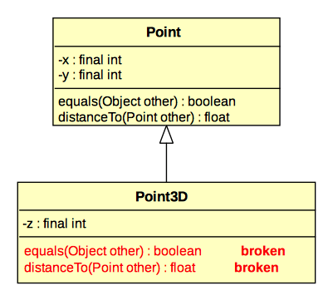

Slide 26
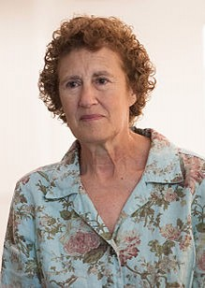
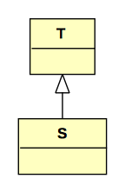
Liskov Substitution Principle
“Strong Behaviorial Subtyping”
“If S is a subtype of T,
then objects of type T
may be replaced with
objects of type S without
altering any of the desirable
properties of the program”
https://en.wikipedia.org/wiki/Liskov_substitution_principle

Slide 27
Assignment 1
Which methods were hard?

Slide 28
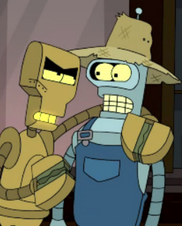
Assignment 1
clamp()
unscheduleAllEvents()
isOccupied()
shiftView()
getAnimationPeriod()
createXXX()
executeXXXActivity()
parseXXX()

